Slide 1
Storage and I/O devices
ICT 103
Lecture 3

Slide 2
Storage and I/O devices
ICT 103
Lecture 3

Slide 3
Types of Storage:
Storage systems are the devices used for data storage. The main objective of the storage system is to permanently store data. The storage systems can be classified as follows:
(1) Magnetic
(2) Optical
(3) Solid state
(4) Magneto Optical

Slide 4
Magnetic Storage Devices
Magnetic storage systems can be defined as the storage systems that store the data on a magnetised medium, with the help of magnetised particles.
Magnetic tapes, magnetic disks, hard disks, floppy disks are examples of magnetic storage systems.
Can store any type of data, such as text, audio, video, image

Slide 5
Magnetic Storage Devices
Magnetic Disks:
A flat disk that is covered with magnetic coating for holding information.
It is used to store digital information in the form of small and magnetised needles.
These needles help in encoding a single bit of information by getting polarized in one direction represented by 1, and opposite direction represented by 0.
It allows the random access of data and provides the facility of erasing and re-recording the data as many times as required.

Slide 6
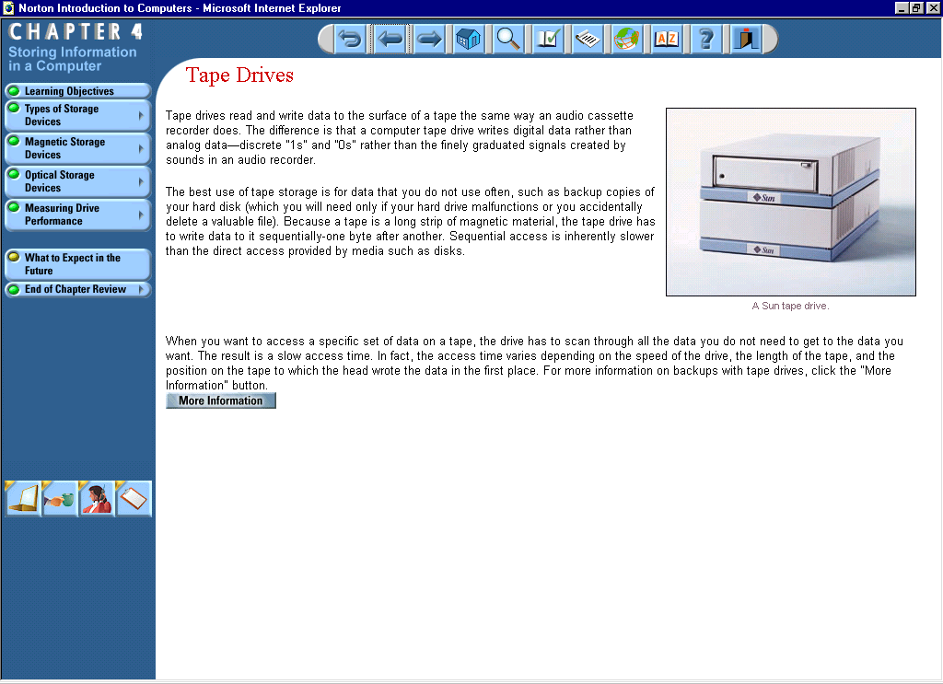
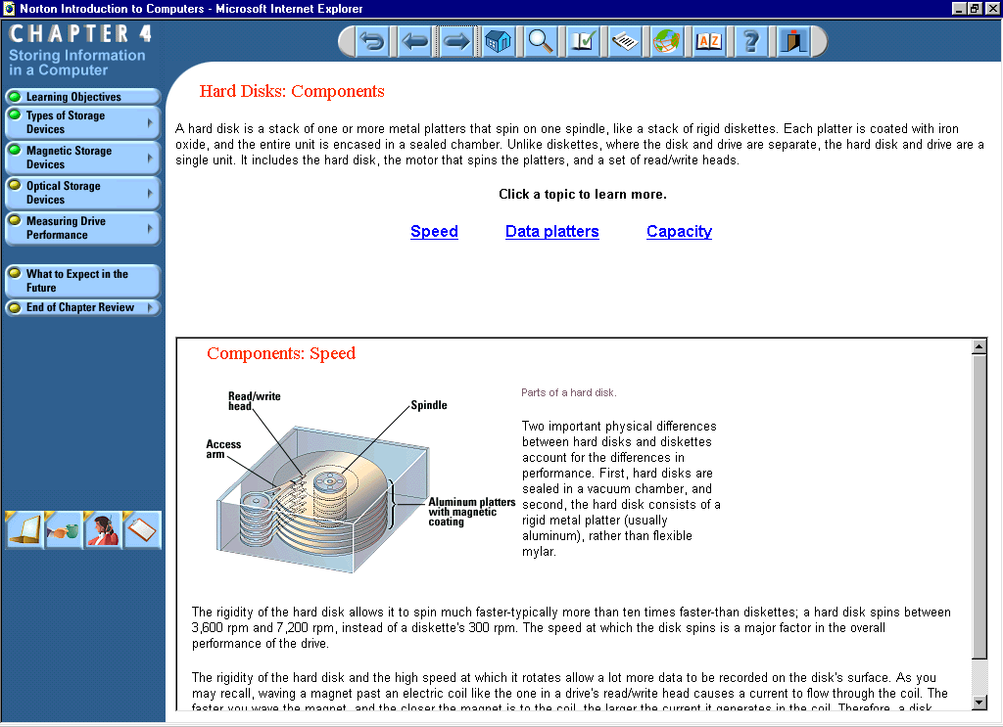
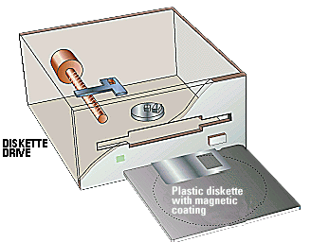
Magnetic Storage Devices
Examples are: Hard disks, Removable hard disks
Magnetic tape.
Tape drive
Hard Drive
Floppy Drive

Slide 7
Optical Storage Devices
The optical storage systems use the laser light as the optical medium to retrieve as well as record data.
The optical storage devices are either read-only or writable.
Examples are Compact Disk Read-Only Memory (CD-ROM),Rewritable disks, DVD-ROM.

Slide 8
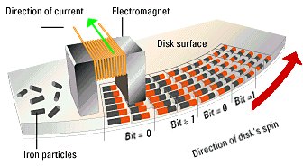
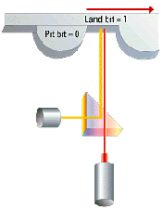
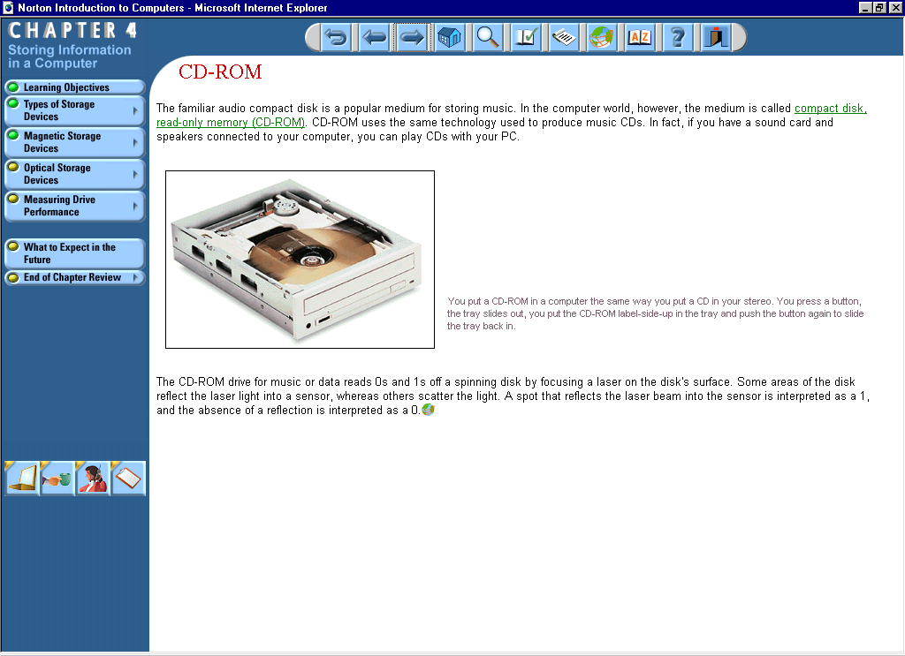
Optical: the bits
are read
using light.
Magnetic: the bits
are written and read
using magnetism.
CD-ROM

Slide 9
Solid-State Storage Devices
Solid-state Storage Devices were developed in 1978 by Storage Tek Company.
Do not use magnetic and optical medium to store data. Instead, use the semiconductor devices.
Contains all the properties of hard disk drives to store the data and use solid-state memory, which has no moving parts.
The examples of SSD are flash memory cards and Universal Serial Bus (USB) devices.

Slide 10
Storage Evaluation Criteria:
Access Mode: random access mode, sequential access mode, direct access mode.
Access Time: the time taken by the processor in completing the requests made by the user for performing the read and write operations.
Storage Capacity: the size of the memory available for storing the data, and measured in terms of bytes.
Storage Type: Temporary and permanent memory.
Cost: the cost of the storage device used in the computer system for holding the data.

Slide 11
Factors that Affect Drive Performance:
Average Access Time
Data-transfer Rate

Slide 12
Factors that Affect Drive Performance:(Cont.)
Average Access Time
The average time it takes a read/write head to move from one place on the recording medium to any other place on the medium.
Data-transfer Rate
A measure of how long it takes the device to read or write a given amount of data.

Slide 13
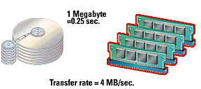
Head
Hard drive
RAM

Slide 14
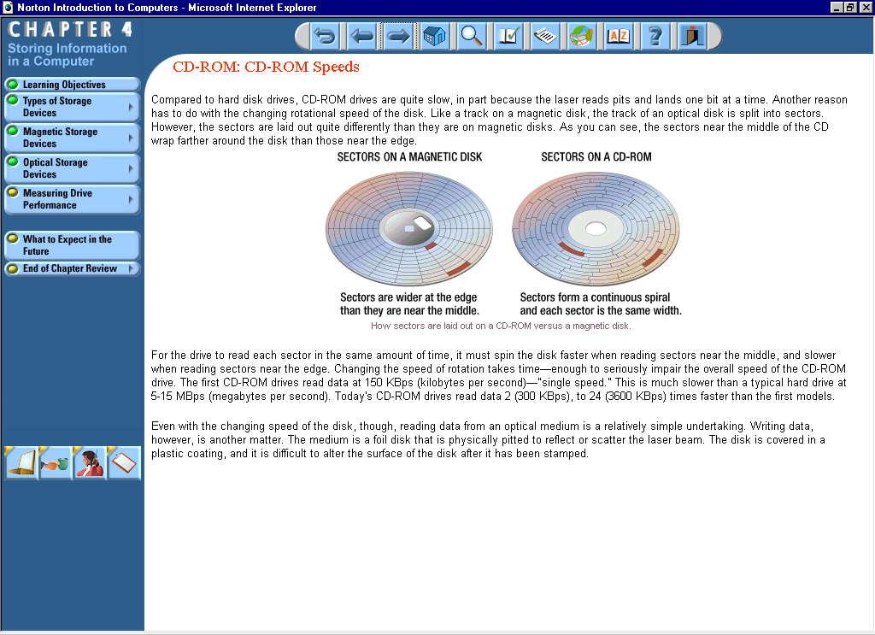
Formatting
The process of mapping a diskette by dividing it into Tracks and Sectors.
Tracks - A set of magnetic concentric circles.
Sector – A pie-like slice of disk.

Slide 15
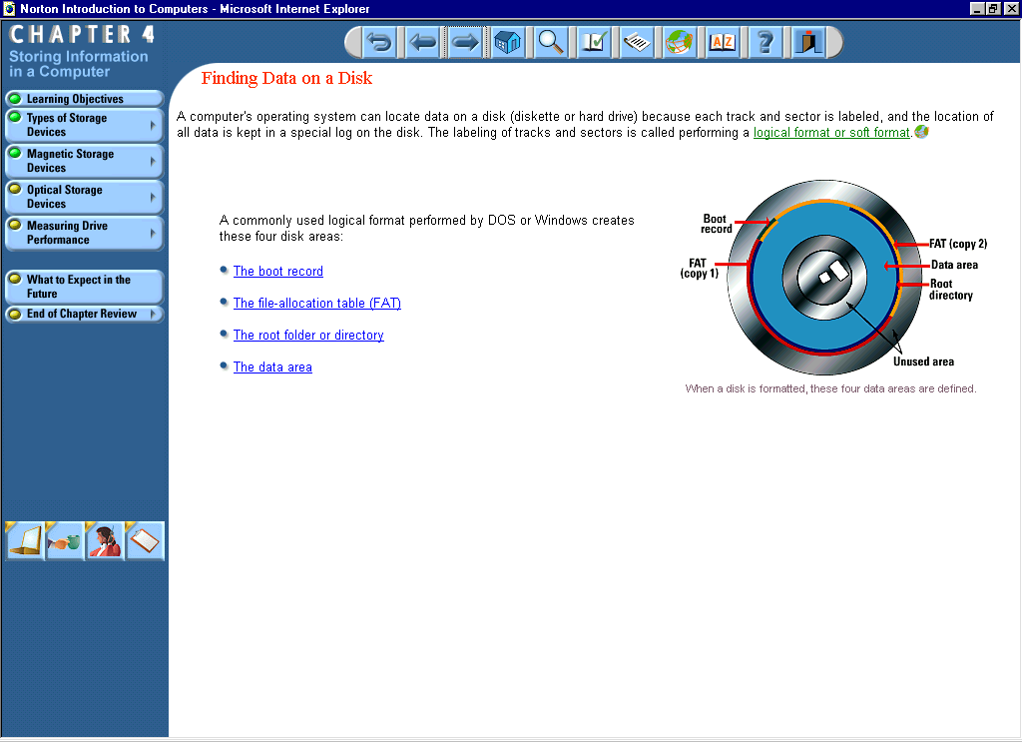
Four Areas of a Disk:
The boot record
The file-allocation table (FAT)
The root folder or directory
The data area

Slide 16
Input Devices

Slide 17
Input Devices:
Keyboard
Mouse
Trackball
Trackpad
Pen
Touch Screen
Bar Code Reader
Image Scanner
Microphone
Video

Slide 18
Parts of a Keyboard:
Keyboard is the most commonly used input device. We can use a keyboard to type data and text and execute commands. A standard keyboard consists of the following groups of keys:
Alphanumeric Keys
Modifier Keys
Numeric Keypad
Function Keys
Cursor-movement Keys
Escape Key
Special-purpose Keys

Slide 19
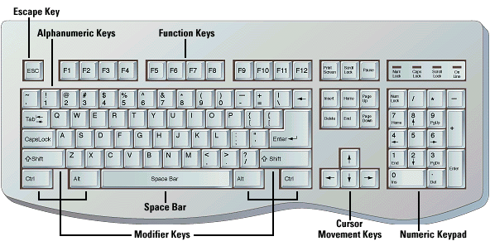

Slide 20
Parts of a Keyboard:
1)Alphanumeric keys: The alphanumeric keys include the number keys and alphabet keys. These keys are arranged in the same style as in the normal typewriters, popularly known as QWERTY layout.
2) Function keys: Arranged in a row on the top of the keyboard. Help perform specific tasks, such as searching a file or refreshing a web page.

Slide 21
Parts of a Keyboard:
(3) Central keys: Used for controlling the movement of cursor and screen display. Include arrow keys, modifier keys such as SHIFT, ALT, CTRL.
(4) Numeric keypad: Located on the right side of the keyboard. This looks like a calculator’s keypad.
(5) Special purpose keys: Escape, Insert, Delete, Print Screen, Pause, Tab, Spacebar.

Slide 22
Pointing Devices
Pointing devices are the input devices that are generally used for moving the cursor to a particular location to point an object on the screen.
With the help of pointing devices, we can easily select the icons, menus, windows, etc. on the Graphical User Interface.
Some of the commonly used pointing devices are:
(1) Mouse
(2) Trackball
(3) Light pen
(4) Joystick
(5) Touchscreen

Slide 23
Mouse
A small hand-held pointing device that basically controls the two-dimensional movement of the cursor on the displayed screen.
The most commonly used types of mouse are:
(1) Mechanical mouse
(2) Optical mouse

Slide 24
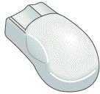
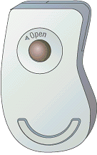
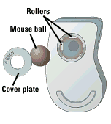
Right
click
The mouse is a fairly
intuitive input device.
When it gets sluggish, turn it
over and remove the cover plate.
Left
click
Carefully clean the ball and rollers.

Slide 25
Scanning Devices
Scanning devices are the input devices that can electronically capture text and images, and convert them into computer readable form.
The basic task of a scanning devices is to convert an image or the textual data into digital data, i.e., in the form of boxes, where each box represents either zero or one. The resultant matrix is known as bit map and is displayed on the screen.

Slide 26
Scanning Devices(Cont.)
The scanning devices can be differentiated from each other on the basis of the following characteristics:
Resolution: the closeness of the pixels in the bit map, and vary from 72 to 600 dots per inch (dpi);
Size: the small sized scanning device can scan approximately two to five inches of the document, whereas the large sized one can scan approximately up to forty inches of the document.

Slide 27
Scanning Devices(Cont.)
The scanning devices can be categorized as follows:
Hand-held scanners: are suitable for scanning small images rather than the whole page of text or pictures, and are generally used for identifying the bar-code label of the products.
Flat-bed scanners: consist of a flat surface composing of glass pane on which the documents are kept for scanning. Under this glass pane, there is xenon light and a CCD, which consists of an array of red, green and blue filters.

Slide 28
Scanning Devices(Cont.)
Drum scanners: consist of a large drum, which is used for scanning the documents. These scanners make use of the PMT technology, instead of the CCD technology. The resolution image of these scanners is very high, ranges form 8000 dpi to 11000 dpi.
Slide scanners: are used for scanning slides as well as film negatives. These scanners are also known as film scanners as they can easily scan the original image of the film. The dark areas appear light and the light areas appear dark.

Slide 29
Optical Recognition Devices
Optical recognition devices are used for recognizing the characters optically. The optical recognition devices basically make use of optical scanner for inputting data. Unlike keyboards, the optical recognition devices do not enter the data by pressing the keys. They help the users in saving a lot of time. Commonly used optical recognition devices are:
Optical Character Recognition (OCR) devices: scan a particular document by recognizing its individual characters and converting it into the editable form.

Slide 30
Optical Recognition Devices(Cont.)
Optical Mark Recognition (OMR) devices: help in obtaining the data from the marked fields. These devices prove to be of great use in recognizing characters in question sheets, enrolment forms, registration forms, employee payroll, etc. Most popularly, the OMR devices are used for scanning the documents having multiple choices as in the question papers used in schools, colleges, etc.

Slide 31
Optical Recognition Devices(Cont.)
Magnetic Ink Character Recognition (MICR) devices:
special devices used for recognizing the characters written with magnetic ink consisting of iron oxide particles. These devices were specially developed for the banking operations. The details on the bank cheques, such as cheque number, bank and branch code are written wit h the magnetic.

Slide 32
Media Input Devices
The input devices, which are generally used in media for communicating with the mass audiences, are known as media input devices. The following are the most popularly used media input devices:
Microphone
Webcam
Graphics tablet

Slide 33
Output Devices

Slide 34
Output Devices
Output devices receive the processed data (information) from the CPU and present it to the user in a desired form. They act as an interface between the computer and the user.
The main task of an output device is to convert the machine readable information into human-readable from which may be in the form of text, graphics, audio or video. Depending upon the form of output required, the output device may belong to one of the following categories:

Slide 35
Output Devices
Display monitors
Printers
Plotters
Voice output systems
Projectors

Slide 36
Display Monitor
Earlier the display monitors were capable of displaying the characters only in a single font and in a single color. These characters were arranged in a rectangular grid on the screen.
The display screens, which are available today, support many fonts and colors.
Different types of display monitors use different technology for displaying the data.

Slide 37
Display Monitor(Cont.)
Cathode Ray Tube (CRT) Monitor: contain an empty glass tube with a phosphor coated fluorescent screen and a source of electrons known as electron gun. A CRT monitor has many advantages, such as a high contrast ratio and color depth. It also provides a change in the resolution without affecting the clarity of the picture. But it is very bulky and occupies a lot of space on the desk. It also consumes a lot of power and produces a large amount heat.

Slide 38
Display Monitor(Cont.)
Liquid Crystal Display (LCD) Monitor: Use liquid crystals technology to display the images. An LCD monitor is small in size and light in weight so it occupies less space on the desk. Also, the power consumption by an LCD monitor is very less. However, it has a weak color quality as compared to a CRT monitor.
Thin Film Transistor (TFT) Monitor: A TFT monitor is similar to an LCD monitor except for one difference that it uses thin film transistor technology along with liquid crystal technology to improve the quality of the image.

Slide 39
Factors Affecting Monitors:
Size
Resolution
Refresh rate
Dot pitch

Slide 40
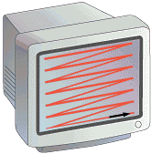
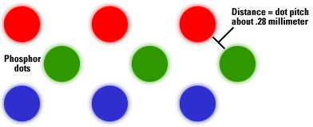
Size is measured
diagonally.
The picture is scanned
from left to right and
from top to bottom.
One complete set of scan
lines is called a frame.
Refresh rate = number of
frames in one second
Resolution = no. of pixels
(i.e. 1024 x 768)
1 pixel in a color monitor

Slide 41
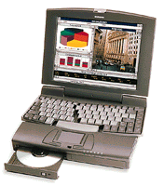
Flat-Panel Monitors:
LCD (Liquid Crystal Display)
    Passive Matrix
    Active Matrix
(Notebooks use LCD displays)

Slide 42
Printers
A printer is a computer hardware that generates the hardcopy of the information processed by a computer system.
Impact Printers: there exists a mechanical contact between print head and paper. Print head is the part of the printer that resembles a hammer and is responsible for transferring the ink to the paper in the form of required characters. Impact printer contains an individual print head for each character.
Non-Impact Printers: there exists no mechanical contact between the print head and paper. These printers spray ink on the paper with the help of a nozzle. The most popular ones are ink-jet printers and laser printers.

Slide 43
Types of Printers:
Ink Jet
Laser
Dot-Matrix
Thermal-Wax
Dye-Sub
Fiery
IRIS
Plotter

Slide 44
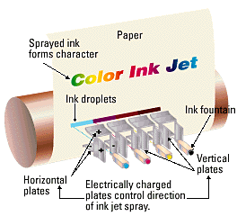
Ink jets are popular because of their
relatively low cost and color capability.

Slide 45
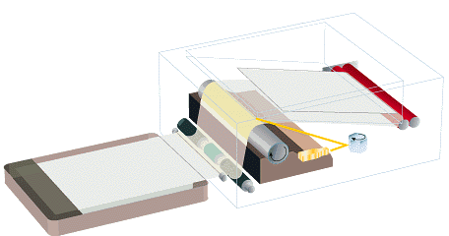
Laser printers are faster and capable of high resolution.
Heat roller bonds
toner to paper
Toner transferred
from drum to paper
Rotating
mirror
Laser beam
Laser transfers
image to drum
Paper is given a
static charge

Slide 46
Printer Criteria:
Image Quality
Speed
Initial Cost
Cost of Operation

Slide 47
Plotters
Plotter is a device used to print high quality graphics and images. It uses one or more pens to produce a high quality drawing. These pens change their positions and draw continuous lines to produce an image. The plotters were used as a substitute to the colored printers when the printers were very expensive and were also not capable of drawing bigger images such as graphs.

Slide 48
Voice Output Systems
Voice output systems record the simple messages in human speech form and then combine all these simple messages to form a single message. The voice response system is of two types:
(1) a reproduction of human voice and other sounds
(2) speech synthesis.
The basic application of a voice output system is in Interactive Voice Response systems, which are used by the customer care or customer support departments of an organization, such as telecommunication companies, etc.

Slide 49
Projectors
A projector is a device that is connected to a computer or a video device for projecting an image from the computer or video device onto the big white screen.
A projector consists of an optic system, a light source and displays, which contain the original images.
Projects were initially used for showing films but now they are used on a large scale for displaying presentations in various situations.

Slide 50
Thank You

